Slide 1
Neural Networks
Chapter 18.6.3, 18.6.4, 18.7
and “Deep Learning” paper
Notes:
Description of Presentations
CLICK SLIDE: click once for entire slide
CLICK EACH: click once for each main heading
CLICK EACH SUB: click once for each main heading and all subheadings
CLICK ANIM: click for each step of animation

Slide 2
Introduction
Neural Networks are a fine-grained, parallel, distributed, computing model
Known as
Neural Networks (NNs)
Artificial Neural Networks (ANNs)
Connectionist Models
Parallel Distributed Processing (PDP) Models
Notes:
CLICK EACH

Slide 3

NNs are inspired by the brain:
knowledge is acquired experientially (learning)
knowledge stored in connections (weights)
Brain composed of neurons:
dendrites collect input from ~10⁴ other neurons
single axon sends output to other neurons
connected at synapses that have varying strength
this model is greatly simplified
Notes:
CLICK EACH

Slide 4
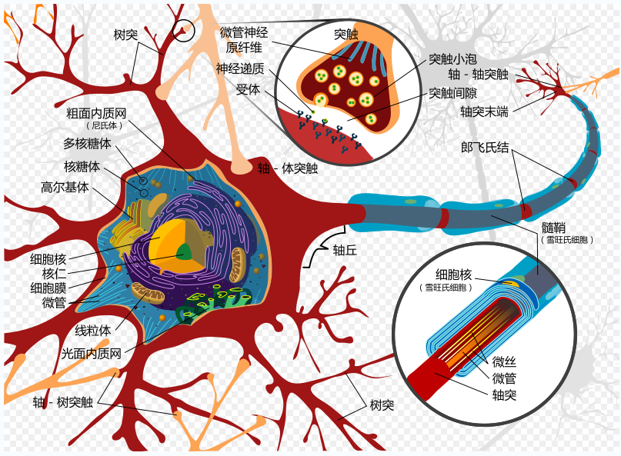

Slide 5
生物神经元
细胞体(Cell Body或者Soma)：由细胞核、细胞质、细胞膜等组成。
神经元的新陈代谢中心，同时还用于接收并处理从其它神经元传递过来的信息。
细胞膜内外有电位差，称为膜电位，膜外为正，膜内为负，大小约为几十微伏。细胞膜通过改变对Na+、K+、Cl-等离子的通透性从而改变膜电位。
膜电压接受其它神经元的输入后，电位上升或者下降。
若输入冲动的时空整合结果使膜电位上升，并超过动作电位阈值时，神经元进入兴奋状态，产生神经冲动，由轴突输出。
若整合结果使膜电位下降并低于动作电压阈值时，神经元进入抑制状态，无神经冲动输出。

Slide 6
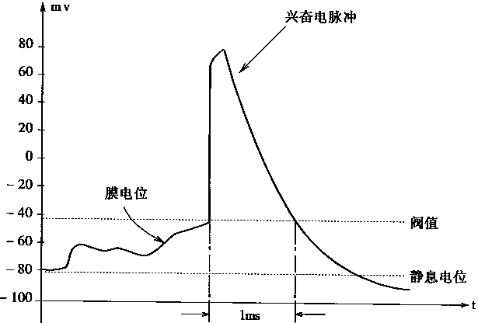
生物神经元
神经元的兴奋过程电位变化

Slide 7
轴突(Axon)：细胞体向外伸出的最长的一条分枝，即神经纤维，相当于神经元的输出端。
一般一个神经元只有一个轴突，有个别神经元没有。
树突(Dendrite)：细胞体向外伸出的触轴突之外其它分枝。一般较短，但分枝很多，相当于神经元的输入端。

Slide 8
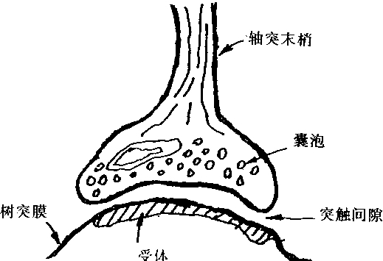
突觸
突触结构

Slide 9
突触(Synapse)：生物神经元之间的相互连接从而让信息传递的部位被称为突触。
突触按其传递信息的不同机制，可分为化学突触和电突触、其中化学突触占大多数，其神经冲动传递借助于化学递质的作用。
突触的信息传递只能从突触前到突触后，不存在反向活动的机制，因此突触传递是单方向的。
根据突触后膜电位电位的变化，突触可分为两种：兴奋性突触和抑制性突触。
神经元对信息的接受和传递都是通过突触来进行的。单个神经元可以从别的细胞接受多达上千个的突触输入。这些输入可达到神经元的树突、胞体和轴突等不同部位，但其分布各不相同，对神经元的影响也不同。突触的信息传递特性可变，因此细胞之间的连接强度可变，这是一种柔性连接，也称为神经元结构的可塑性。

Slide 10
生理学的研究表明，突触可以有以下几个方面的变化：
(1)突触传递效率的变化。首先是突触的膨胀以及由此产生的突触后膜表面积扩大，从而突触所释放出的传递物质增多，使得突触的传递效率提高。其次是突触传递物质质量的变化，包括比例成分的变化所引起传递效率的变化。
(2)突触接触间隙的变化。在突触表面有许多形状各异的小凸芽，调节其形状变化可以改变接触间隙，并影响传递效率。
(3)突触的发芽。当某些神经纤维被破坏后，可能又会长出新芽，并重新产生附着于神经元上的突触．形成新的回路。由于新的回路的形成，使得结合模式发生变化，也会引起传递效率的变化。
(4)突触数目的增减。由于种种复杂环境条件的刺激等原因，或者由于动物本身的生长或衰老，神经系统的突触数目会发生变化，并影响神经元之间的传递效率。

Slide 11
神经元的整合功能
神经元对信息的接受和传递都是通过突触来进行的。
单个神经元可以从别的细胞接受多个输入。由于输入分布于不同的部位，对神经元影响的比例(权重)是不相同的。另外，各突触输入抵达神经元的先后时间也不一祥。因此，一个神经元接受的信息，在时间和空间上常呈现出一种复杂多变的形式，需要神经元对它们进行积累和整合加工，从而决定其输出的时机和强度。正是神经元这种整合作用，才使得亿万个神经元在神经系统中有条不紊、夜以继日地处理各种复杂的信息，执行着生物中枢神经系统的各种信息处理功能。
多个神经元以突触联接形成了一个神经网络。
研究表明，生物神经网络的功能决不是单个神经元生理和信息处理功能的简单叠加，而是一个有层次的、多单元的动态信息处理系统。它们有其独特的运行方式和控制机制，以接受生物内外环境的输入信息，加以综合分折处理，然后调节控制机体对环境作出适当的反应。

Slide 12
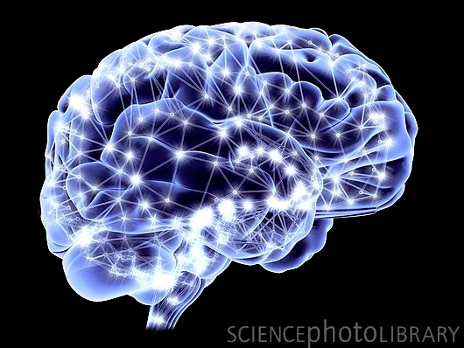
number of neurons: ~10¹¹
number of connections: ~10⁴ per neuron
Processing speed: ~100 Hz

Slide 13
人脑神经系统的特征（1）
从信息系统研究的观点出发，对于人脑这个智能信息处理系统，有如下一些固有特征：
(1)并行分布处理的工作模式。
实际上大脑中单个神经元的信息处理速度是很慢的，每次约1毫秒(ms)，比通常的电子门电路要慢几个数量级。每个神经元的处理功能也很有限，估计不会比计算机的一条指令更复杂。
但是人脑对某一复杂过程的处理和反应却很快，一般只需几百毫秒。例如要判定人眼看到的两个图形是否一样，实际上约需400 ms，而在这个处理过程中，与脑神经系统的一些主要功能，如视觉、记亿、推理等有关。按照上述神经元的处理速度，如果采用串行工作模式，就必须在几百个串行步内完成，这实际上是不可能办到的。因此只能把它看成是一个由众多神经元所组成的超高密度的并行处理系统。例如在一张照片寻找一个熟人的面孔，对人脑而言，几秒钟便可完成，但如用计算机来处理，以现有的技术，是不可能在短时间内完成的。由此可见，大脑信息处理的并行速度已达到了极高的程度。

Slide 14
人脑神经系统的特征（2）
(2)神经系统的可塑性和自组织性。
神经系统的可塑性和自组织性与人脑的生长发育过程有关。例如，人的幼年时期约在9岁左右，学习语言的能力十分强，说明在幼年时期，大脑的可塑性和柔软性特别良好。从生理学的角度看，它体现在突触的可塑性和联接状态的变化，同时还表现在神经系统的自组织特性上。例如在某一外界信息反复刺激下。接受该信息的神经细胞之间的突触结合强度会增强。这种可塑性反映出大脑功能既有先天的制约因素，也有可能通过后天的训练和学习而得到加强。神经网络的学习机制就是基于这种可塑性现象，并通过修正突触的结合强度来实现的。
(3)信息处理与信息存贮合二为一。
大脑中的信息处理与信息存贮是有机结合在一起的，而不像现行计算机那样．存贮地址和存贮内容是彼此分开的。由于大脑神经元兼有信息处理和存贮功能，所以在进行回亿时，不但不存在先找存贮地址而后再调出所存内容的问题，而且还可以由一部分内容恢复全部内容。

Slide 15
人脑神经系统的特征（3）
(4)信息处理的系统性
大脑是一个复杂的大规模信息处理系统，单个的元件“神经元”不能体现全体宏观系统的功能。实际上，可以将大脑的各个部位看成是一个大系统中的许多子系统。各个子系统之间具有很强的相互联系，一些子系统可以调节另一些子系统的行为。例如，视觉系统和运动系统就存在很强的系统联系，可以相互协调各种信息处理功能。
(5)能接受和处理模糊的、模拟的、随机的信息。
(6)求满意解而不是精确解。
人类处理日常行为时，往往都不是一定要按最优或最精确的方式去求解，而是以能解决问题为原则，即求得满意解就行了。
(7)系统的平滑退化和冗余备份(健壮性和容错性)。

Slide 16
Neural Network Architecture
large number of units
simple neuron-like processing elements
connected by a large number of links
directed from one unit to another
a weight associated with each link
positive or negative real values
means of long term storage
adjusted by learning
an activation function associated with each unit
result of the unit's processing
unit's output
Notes:
CLICK EACH SUB

Slide 17
Neural Network Architecture
represent as a graph
Nodes: units
Arcs: links
single layer
multi-layer
Feedback (cycles)?
layer skipping?
Layer 3
fully connected?
Layer 2
Layer 1
Notes:
CLICK EACH SUB

Slide 18
Basics of NN
Structure of a “Unit”:
set of input links
from other units or sensors of the environment
set of output links
to other units or effectors of the environment
an activation function
computes the output activation value using a simple non-linear function of the linear combination of its inputs
Notes:
CLICK EACH SUB

Slide 19
Basics of NN
Given n inputs, the unit's activation (i.e., output) is defined by:
where
w_{i} are the weights
x_{i} are the input values
g( ) is a simple, non-linear function, commonly:
step: activation flips from 0 to 1 when in ≥ threshold
tanh: g(in) = tanh(in)
sigmoid / logistic: g(in) = 1 / (1 + exp(-in))
rectified linear: g(in) = max(0, in)
Notes:
CLICK EACH SUB
step_{t}(x) = 1, if x >= t 0, if x < t
sign(x) = +1, if x >= 0 -1, if x < 0
sigmoid(x) = 1/(1+e^-x)

Slide 20
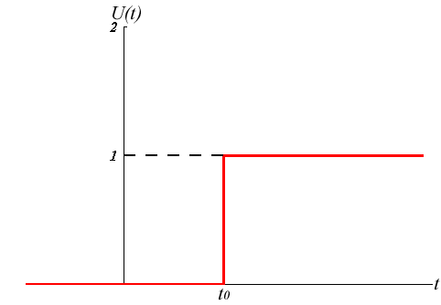
Step Function (LTU)

Slide 21
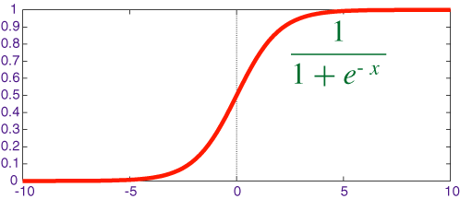
Sigmoid Function

Slide 22
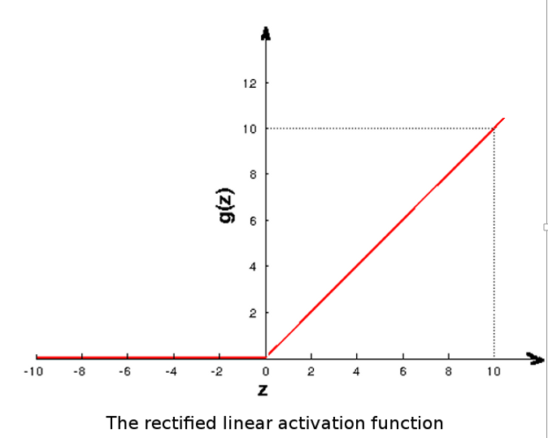
Rectified Linear Function (ReLU)

Slide 23
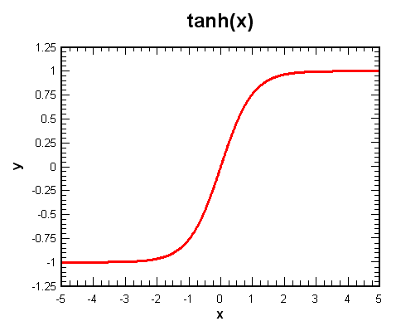
Hyperbolic Tangent Function

Slide 24
Perceptrons
Studied in the 1950s, mainly as simple networks for which there was an effective learning algorithm
“1-layer network”: one or more output units
“Input units” don’t count because they don’t compute anything
Output units are all linear threshold units (LTUs)
a unit's inputs, x_{i}, are weighted, w_{i}, and linearly combined
step function computes binary output activation value, a
w₁
x₁
x_{i}
Σ
t
a
x_{n}
w_{n}
Notes:
CLICK EACH SUB, ANIM
multi-unit 1 layered perceptrons are collection of independent units since no connection between units

Slide 25
Linear Threshold Units (LTU)
Threshold is just another weight (called the bias):
(w₁ x₁) + (w₂ x₂) + ... + (w_{n} x_{n}) ≥ t
which is equivalent to
(w₁ x₁) + (w₂ x₂) + ... + (w_{n} x_{n}) + (t (-1)) ≥ 0
Use +1 instead of -1, however
+1
t
x₁
w₁
a
x_{n}
w_{n}
Notes:
CLICK EACH SUB, ANIM

Slide 26
Perceptron Examples
+1
“AND” Perceptron:
inputs are 0 or 1
output is 1 when both x₁ and x₂ are 1
-0.75
x₁
0.5
a
x₂
0.5
2D input space
.5*1+.5*0-.75*1
=-.25 output = 0
x₁
.5*1+.5*1-.75*1
=.25 output = 1
4 possible data points
1
.5*0+.5*0-.75*1
=-.75 output = 0
threshold is like a separating line
0
x₂
0
1
Notes:
CLICK EACH SUB, ANIM

Slide 27
Perceptron Examples
+1
“OR” Perceptron:
inputs are 0 or 1
output is 1 when either x₁ or x₂ are 1
-0.25
???
x₁
0.5
a
x₂
0.5
2D input space
.5*1+.5*0-.25*1
=.25 output = 1
x₁
.5*1+.5*1-.25*1
=.75 output = 1
4 possible data points
1
.5*0+.5*0-.25*1
=-.25 output = 0
threshold is like a separating line
0
x₂
0
1
Notes:
CLICK EACH SUB, ANIM

Slide 28
Perceptron Learning
How are the weights learned by a Perceptron?
Programmer specifies:
numbers of units in each layer
connectivity between units
Only unknown is the set of weights
Learning of weights is supervised
for each training example a list of values for each input units of the network
the correct output is given a list of values for the desired output of all output units
Notes:
CLICK EACH SUB

Slide 29
Perceptron Learning Algorithm
Initialize the weights in the network (usually with random values)
Repeat until all examples correctly classified or some other stopping criterion is met
foreach example, e, in the training set do
O = neural_net_output(network, e);
T = desired output, i.e., Target or Teacher's output;
update_weights(e, O, T);
Each pass through all of the training examples is called an epoch （回合）
Step 2 requires multiple epochs
Notes:
CLICK EACH SUB

Slide 30
Perceptron Learning Rule
How should the weights be updated?
Determining how to update the weights is an instance of the credit assignment problem
Perceptron Learning Rule:
w_{i} = w_{i} + Δw_{i}
where Δw_{i} = α x_{i} (T - O)
x_{i} is the input associated with i^{th} input unit
α is a real-valued constant between 0.0 and 1.0 called the learning rate
Notes:
CLICK EACH SUB

Slide 31
Perceptron Learning Rule (PLR)
Δw_{i} = α x_{i} (T - O) doesn't depend on w_{i}
No change in weight (i.e., Δw_{i} = 0) if:
correct output, i.e., T = O
0 input, i.e., x_{i} = 0
If T=1 and O=0, increase the weight
so that maybe next time the result will exceed the output unit's threshold, causing it to be 1
If T=0 and O=1, decrease the weight
so that maybe next time the result won't exceed the output unit's threshold, causing it to be 0
Notes:
CLICK EACH SUB

Slide 32
Example: Learning OR
Δw_{i} = α(T – O)x_{i} = 0.2(T – O)x_{i}
Initial network:
LTU
0.8
LTU
0
0.1
0.5
w₁ = 0.1
w₃ = -0.8
w₂ = 0.5
x₁
x₂
x₁
x₂
+1
Notes:
CLICK SLIDE

Slide 33
Example: Learning OR
bias
T
O
x1 | x2 | t | a | Δw1 | w1 | Δw2 | w2 | Δw3 | w3
 |  |  |  |  | 0.1 |  | 0.5 |  | -0.8
0 | 0 | 0 | 0 | 0 | 0.1 | 0 | 0.5 | 0 | -0.8
0 | 1 | 1 | 0 | 0 | 0.1 | 0.2 | 0.7 | 0.2 | -0.6
1 | 0 | 1 | 0 | 0.2 | 0.3 | 0 | 0.7 | 0.2 | -0.4
1 | 1 | 1 | 1 | 0 | 0.3 | 0 | 0.7 | 0 | -0.4
0 | 0 | 0 | 0 | 0 | 0.3 | 0 | 0.7 | 0 | -0.4
0 | 1 | 1 | 1 | 0 | 0.3 | 0 | 0.7 | 0 | -0.4
1 | 0 | 1 | 0 | 0.2 | 0.5 | 0 | 0.7 | 0.2 | -0.2
1 | 1 | 1 | 1 | 0 | 0.5 | 0 | 0.7 | 0 | -0.2
0 | 0 | 0 | 0 | 0 | 0.5 | 0 | 0.7 | 0 | -0.2
0 | 1 | 1 | 1 | 0 | 0.5 | 0 | 0.7 | 0 | -0.2
1 | 0 | 1 | 1 | 0 | 0.5 | 0 | 0.7 | 0 | -0.2
1 | 1 | 1 | 1 | 0 | 0.5 | 0 | 0.7 | 0 | -0.2

Slide 34
Perceptron Learning Rule (PLR)
PLR is a “local" learning rule in that only local information in the network is needed to update a weight
PLR performs gradient descent (hill-climbing) in “weight space”
Iteratively adjusts all weights so that for each training example the error decreases (more correctly, error is monotonically non-increasing)
Notes:
CLICK EACH

Slide 35
Perceptron Learning Rule (PLR)
Perceptron Convergence Theorem:
If a set of examples are learnable, then PLR will find an appropriate set of weights
in a finite number of steps
independent of the initial weights
with sufficiently small α
This theorem says that if a solution exists, PLR's gradient descent is guaranteed to find an optimal solution (i.e., 100% correct classification) for any 1-layer neural network
Notes:
CLICK EACH
Convergence occurs as long as learning rate isn't too high to cause learning to overshoot.
Convergence shouldn't be surprising because linear separable functions are simple having weight spaces which don't have local minima.

Slide 36
Limits of Perceptron Learning
What Can be Learned by a Perceptron?
Perceptron's output is determined by the separating hyperplane defined by
(w₁ x₁) + (w₂ x₂) + ... + (w_{n} x_{n}) = t
So, Perceptrons can only learn functions that are linearly separable (in input space)
Notes:
CLICK EACH

Slide 37
Separating Hyperplane Example
+1
“AND” Perceptron:
inputs are 0 or 1
output is 1 when both x₁ and x₂ are 1
-0.75
x₁
0.5
a
x₂
0.5
2D “input space”
Separating line equation:
0.5x₁ + 0.5x₂ – 0.75 = 0
or, in slope-intercept form: x₁ = – x₂ + 1.5
x₁
1
0
x₂
0
1
Notes:
CLICK EACH SUB, ANIM

Slide 38
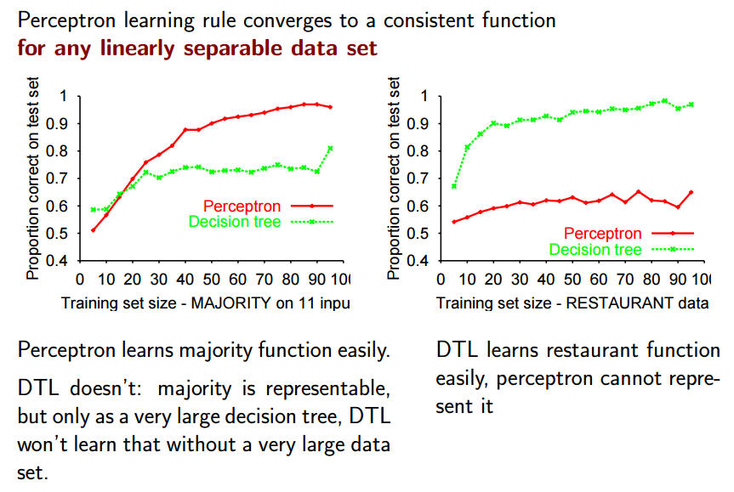

Slide 39
Limits of Perceptron Learning
“XOR” Perceptron?
inputs are 0 or 1
output is 1 when x₁ is 1 and x₂ is 0 or x₁ is 0 and x₂ is 1
+1
???
x₁
.5
a
x₂
.5
x₁
2D input space with 4 possible data points
1
How do you separate + from – using a straight line?
0
x₂
0
1
Notes:
CLICK EACH SUB, ANIM

Slide 40
Perceptron Learning Summary
In general, the goal of learning in a 1-output-unit Perceptron is to adjust the separating hyperplane that divides an n-dimensional “input space,” where n is the number of input units + 1, by modifying the weights (including the bias) until all the examples with target value 1 are on one side of the hyperplane, and all the examples with target value 0 are on the other side of the hyperplane
Notes:
CLICK EACH

Slide 41
Beyond Perceptrons
Perceptrons are too weak a computing model because they can only learn linearly-separable functions
General NN's can have multiple layers of units, which enhance their computational power; the challenge is to find a learning rule that works for multi-layered networks
Notes:
CLICK EACH SUB

Slide 42
Beyond Perceptrons
A Multi-Layer, Feed-Forward Network computes a function of the inputs and the weights
Input units
Input values are given
Output units
activation is the output result
Hidden units (between input and output units)
cannot observe directly
Perceptrons have input units followed by one layer of output units, i.e., no hidden units
Notes:
CLICK EACH SUB

Slide 43
Two-Layer, Feed-Forward Neural Network
a_{i}=I_{i}
w_{i,j}
Input Units
a_{j}
w_{j,k}
a_{k}
Hidden Units
I₁
Output Units
I₂
Weights on links
from input to hidden
a₁ = O₁
I₃
Weights on links from hidden to output
I₄
a₂ = O₂
I₅
Network Activations
I₆
Notes:
CLICK ANIM

Slide 44
Two-Layer, Feed-Forward Neural Network
a_{i}=I_{i}
w_{i,j}
a_{j}
w_{j,k}
a_{k}
Two Layers:
count layers with units computing an activation
I₁
I₂
Feed-Forward:
each unit in a layer connects to all units in
the next layer
a₁ = O₁
I₃
I₄
no cycles
- links within the same layer
- links to prior layers
a₂ = O₂
I₅
no skipping layers
I₆
Layer 1
Layer 2
Notes:
CLICK ANIM
activation from prior time step plays no part in computing current activation

Slide 45
Beyond Perceptrons
NN's with one hidden layer of a sufficient number of units, can compute functions associated with convex classification regions in input space
And can approximate any continuous function
NN's with two hidden layers are universal computing devices, although the complexity of the function is limited by the number of units
If too few, the network will be unable to represent the function
If too many, the network can memorize examples and is subject to “overfitting”
Notes:
CLICK EACH SUB
recurrent networks are multi-layered networks with feedback (cyclic connections). Mutual inhibition links are cyclic links where one output unit connects to other output units.

Slide 46
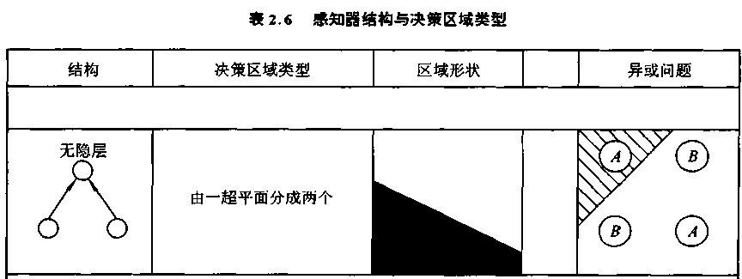
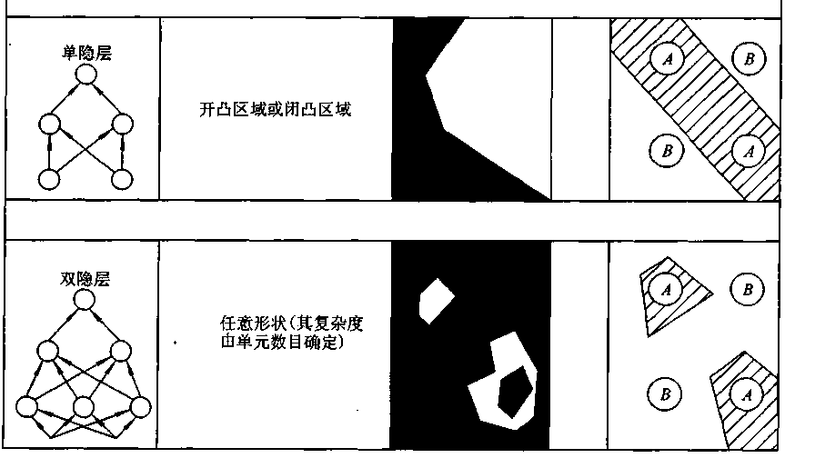

Slide 47
XOR Example
XOR 2-Layer Feed-Forward Network
inputs are 0 or 1
output is 1 when I₁ is 1 and I₂ is 0, or I₁ is 0 and I₂ is 1
-.25
I₁
.5
OR
.5
.5
a
.5
I₂
-.5
AND
Each unit in hidden layer acts like a Perceptron learning a decision line
.5
-.75
I₁
top hidden unit acts like an OR Perceptron
1
bottom hidden unit acts like an AND Perceptron
0
I₂
0
1
Notes:
CLICK EACH SUB, ANIM

Slide 48
XOR Example
XOR 2-Layer Feed-Forward Network
inputs are 0 or 1
output is 1 when I₁ is 1 and I₂ is 0 or I₁ is 0 and I₂ is 1
-.25
I₁
.5
OR
.5
.5
a
.5
I₂
-.5
AND
.5
To classify an example each unit in the output layer combines these decision lines by intersecting their "half-planes”:
-.75
I₁
1
when OR is 1
and AND is 0
0
I₂
then output, a, is 1
0
1
Notes:
CLICK EACH SUB, ANIM
see figure 20.23

Slide 49
Learning in Multi-Layer, Feed-Forward Neural Nets
PLR doesn't work in multi-layered feed-forward nets because the desired values for hidden units are not known
Must again solve the Credit Assignment Problem
determine which weights to credit/blame for the output error in the network
determine which weights in the network should be updated and how to update them
Notes:
CLICK EACH SUB

Slide 50
Learning in Multi-Layer, Feed-Forward Neural Nets
Back-Propogation
Method for learning weights in these networks
Generalizes PLR
Rumelhart, Hinton and Williams, 1986
Approach
Gradient-descent algorithm to minimize the error on the training data
Errors are propagated through the network starting at the output units and working backwards towards the input units
Notes:
CLICK EACH SUB

Slide 51
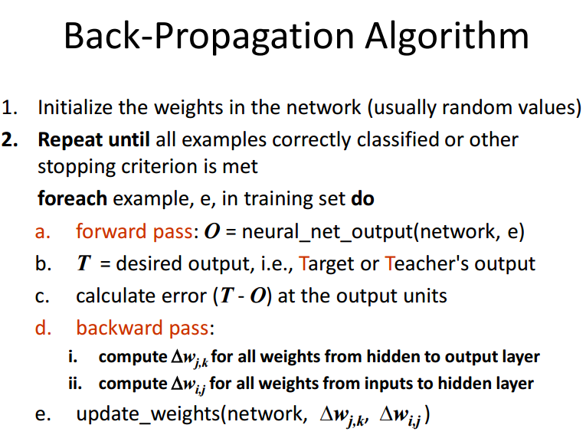
Other strategies exist

Slide 52
Updating the Weights
Back-Propagation performs a gradient descent search in “weight space” to learn the network weights
Given a network with n weights:
each configuration of weights is a vector, W, of length n that defines an instance of the network
W can be considered a point in an n-dimensional weight space, where each dimension is associated with one of the connections in the network
Notes:
CLICK EACH SUB

Slide 53
Updating the Weights
Given a training set of m examples:
Each network defined by the vector W has an associated total error, E, on all the training data
E is the sum squared error (SSE) defined by E = E₁ + E₂ + ... + E_{m}
where E_{i} is the squared error of the network on the i^{th} training example
Given n output units in the network: E_{i} = ½ ((T_{i1} - O_{i1})² + (T_{i2} - O_{i2})² + ... + (T_{in} - O_{in})²)
T_{i} is the target value for the i^{th} example
O_{i} is the network output value for the i^{th} example
Notes:
CLICK EACH SUB

Slide 54
Updating the Weights
Visualized as a 2D error surface in “weight space”
Each point in w₁ w₂ plane is a weight configuration
Each point has a total error E
E
2D surface represents errors for all weight configurations
Goal is to find a lower point on the error surface (local minimum)
w₂
Gradient descent follows the direction of steepest descent, i.e., where E decreases the most
.3
w₁
.8
Notes:
CLICK ANIM

Slide 55
Updating the Weights
The gradient is defined as
Update the i-th weight using
To compute the derivatives for calculating the gradient direction requires an activation function that is continuous, differentiable, non-decreasing and easily computed
Can't use the Step function in LTU's because it’s derivative is 0 everywhere
Instead, let’s use (for now) the Sigmoid（乙狀結腸） function
Notes:
CLICK EACH SUB

Slide 56
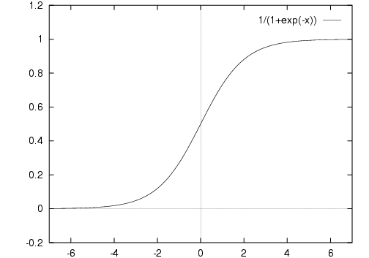
Sigmoid Activation Function
Solution: Replace with a smooth function such as Sigmoid function (aka Logistic Sigmoid function): g_{w}(x) = 1 / (1 + e^{–wx})
Squashes numbers to range [0,1]

Slide 57
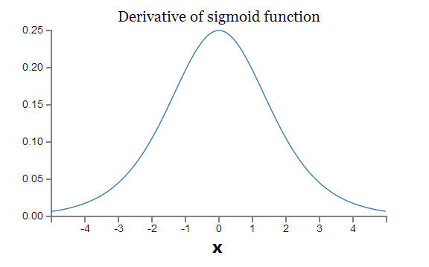
First Derivative of Sigmoid Function
g’（x）= g(x)(1 - g(x))
g’(x)
Notes:
Slope of the sigmoid function

Slide 58
Updating the Weights
O_{j}
I₁
I₂
I₃
w_{i,j}
W_{j,k}
I₄
O_{k}
T_{k}
I₅
Output
Layer k
I₆
Hidden
Layer j
Input
Layer i

Slide 59
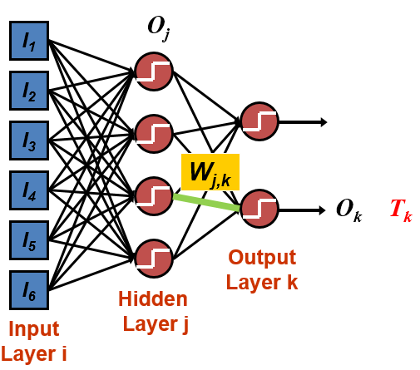
For weights W_{j,k} between hidden and output units

Slide 60
Updating Weights in a 2-Layer Neural Network
For weights between input and hidden units:
we don't have teacher-supplied correct output values
infer the error at these units by "back-propagating"
error at an output unit is "distributed" back to each of the hidden units in proportion to the weight of the connection between them
total error is distributed to all of the hidden units that contributed to that error
Each hidden unit accumulates some error from each of the output units to which it is connected
Notes:
CLICK EACH SUB

Slide 61
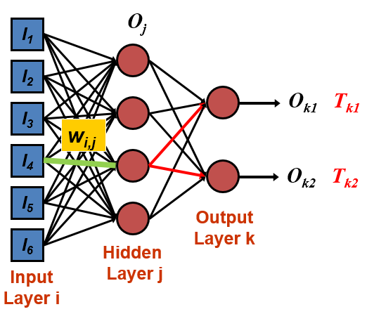
For weights W_{i, j} between input and hidden units

Slide 62
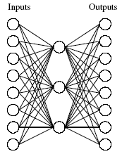
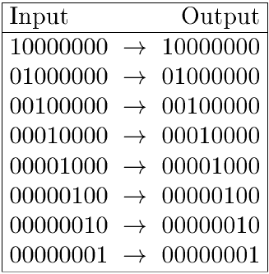
Learning Hidden Layer Representation
Can this be learned?
Slide by Guoping Qiu

Slide 63
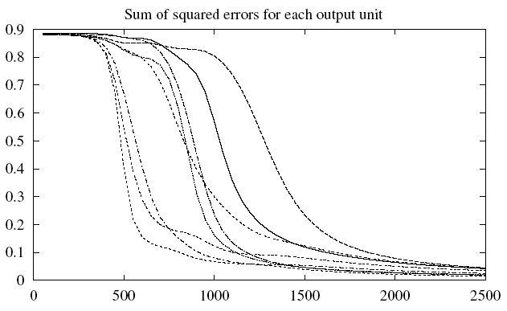
Learning Hidden Layer Representation
Training
# epochs
The evolving sum of squared errors for each of the eight output units
Slide by Guoping Qiu

Slide 64
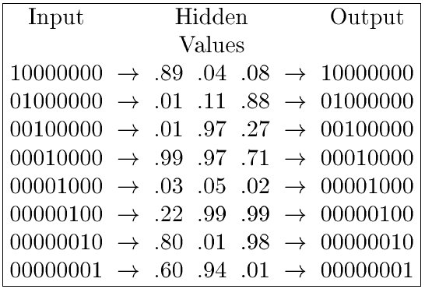
Learning Hidden Layer Representation
Learned hidden layer representation
Slide by Guoping Qiu

Slide 65
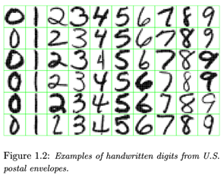
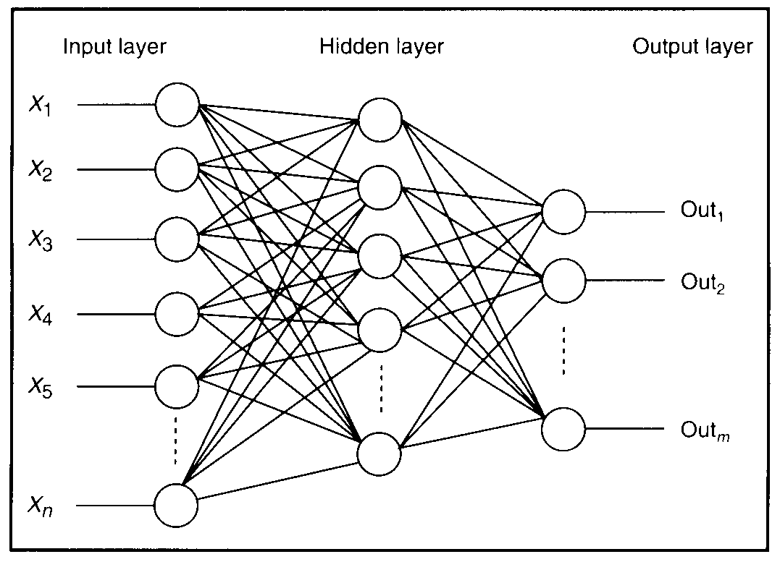
Feature Detectors

Slide 66
What is this Unit Doing?

Slide 67
Hidden-Layer Units learn to be Feature Detectors
1 5 10 15 20 25 …
…
1
strong positive weight
low/zero weight
63

Slide 68
What does this Unit Detect?
1 5 10 15 20 25 …
…
1
strong positive weight
low/zero weight
63

Slide 69
What does this Unit Detect?
1 5 10 15 20 25 …
…
1
strong positive weight
low/zero weight
it will send strong signal for a horizontal
line in the top row, ignoring everywhere else
63

Slide 70
What does this Unit Detect?
1 5 10 15 20 25 …
…
1
strong positive weight
low/zero weight
63

Slide 71
What does this Unit Detect?
1 5 10 15 20 25 …
…
1
strong positive weight
low/zero weight
Strong signal for a dark area in the top left corner
63

Slide 72
What features might you expect a good NN
to learn, when trained with data like this?

Slide 73
vertical lines
1
63

Slide 74
horizontal lines
1
63

Slide 75
Small circles
1
63

Slide 76
Small circles
1
But what about position invariance?
Our example unit detectors were tied to
specific parts of the image
63

Slide 77
Multi-layer Feed-forward Networks
Back-propagation algorithm performs gradient descent over “weight space” of entire network
Always include a bias input at every unit
Use ReLU, not Sigmoid, for activation function
Will, in general, find a local, not global, error minimum
Training can take thousands of epochs, but can be computed efficiently using matrix vector operations and GPU implementation

Slide 78
Forward Pass of a 3-Layer NN
Let x = n x 1 column vector giving input values for n input units
First hidden layer’s weights: W1 = m x n matrix where there are m units in hidden layer
First layer’s biases: b1 = m x 1 column vector
h1 = activations at first hidden layer’s units
f = activation function (e.g., sigmoid)
h1 = f(W1∙x + b1) // calculate 1st hidden layer activations
h2 = f(W2∙h1 + b2) // calculate 2nd hidden layer activations
out = f(W3∙h2 + b3) // calculate output layer activations

Slide 79

How Many Weights?
3 layers, 9 units with activation function,
((3x4)+4) + ((4x4)+4) + ((4x1)+1) = 41 weights incl. biases

Slide 80
Other Issues
How should the learning rate parameter, α, be set?
Use a tuning set to train using several candidate values for α, and then select the value that gives the lowest error
Notes:
CLICK EACH SUB

Slide 81
Setting Parameters
Some learning algorithms require setting learning parameters
They must be set without looking at the test data
One approach: use a tuning set
Notes:
CLICK EACH SUB

Slide 82
Using Data
Training set is used to learn a “model” (e.g., a neural network’s weights)
Tuning set is used to judge and select parameters (e.g., learning rate and the number of hidden units)
Testing set is used to judge in a fair manner the final model’s accuracy
All 3 datasets must be disjoint!

Slide 83
Setting Parameters
Use a Tuning set for setting parameters:
Partition training examples into TRAIN, TUNE, and TEST sets
For each candidate parameter value, learn a neural network using the TRAIN set
Use TUNE set to evaluate error rates and determine which parameter value is best
Compute new neural network using selected parameter value and both TRAIN and TUNE sets
Use TEST set to compute performance accuracy (using cross-validation or leave-one-out)
Notes:
CLICK EACH SUB

Slide 84
Other Issues
When should training stop?
too soon and the concept isn't learned
too late:
overfitting, poor generalization
error rate will go up on the testing set
Train the network until the error rate on a tuning set begins increasing rather than training until the error (i.e., SSE) on the training set is minimized
Notes:
CLICK EACH SUB

Slide 85
Other Issues
How many examples should be in the training set?
The more the better, but training takes longer
To obtain 1 – e correct classification on testing set:
training set should be of size approximately n/e
n is the number of weights in the network
e is test set error fraction between 0 and 1
train to classify 1 - e/2 of the training set correctly
e.g., if n = 80 and e = 0.1 (i.e. 10% error on test set)
Use training set of size is 800
train until 95% correct classification
should produce ~90% correct classification on test set
Notes:
CLICK EACH SUB

Slide 86
Other Issues
How many hidden layers should be in the network?
often just one hidden layer is used
How many hidden units should be in a layer?
too few: concept can't be learned
too many:
examples just memorized
overfitting, poor generalization
Notes:
CLICK EACH SUB

Slide 87
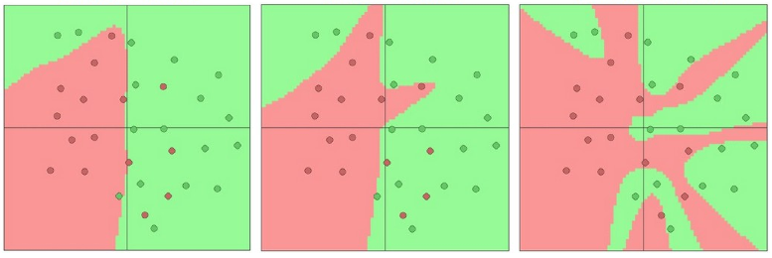
How Many Hidden Units?
Decision regions learned by a 2-layer network:
Larger networks can represent more complicated functions, but make it easier to overfit the training data
3 hidden units
6 hidden units
20 hidden units
Notes:
Data are shown as circles colored by their class, and decision regions are colored.

Slide 88
Application: Autonomous Driving
ALVINN (Pomerleau, 1988) learns to control vehicle steering to stay in the middle of its lane
Topology: 2-layer, feed-forward network using back-propagation learning
Input layer: 480 × 512 image @ 15 frames per second
color image is preprocessed to obtain a 30 × 32 image
each pixel is one byte, an integer from 0 to 255 corresponding to the brightness of the image
networks has 960 input units (= 30 × 32)
Notes:
CLICK EACH SUB

Slide 89
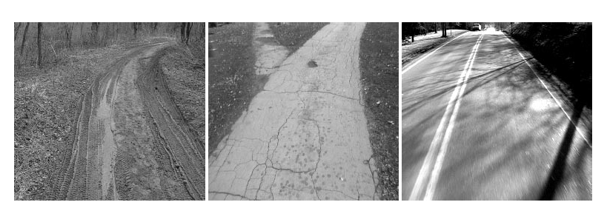
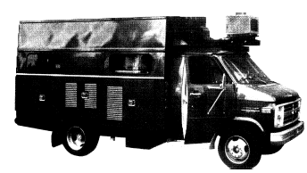
ALVINN
steering direction
[Pomerleau, 1995]

Slide 90
ALVINN
Topology: Output layer
output is one of 30 discrete steering positions
output unit 1 means sharp left
output unit 30 means sharp right
target output is a set of 30 values
Gaussian distribution with a variance of 10 centered on the desired steering direction: O_{i} = e^{[-(i-d)2/10]}
actual output for steering determined by
compute a least-squares best fit of output units' values to a Gaussian distribution with a variance of 10
peak of this distribution is taken as the steering direction
error for learning is: target output - actual output
Notes:
CLICK EACH SUB

Slide 91
ALVINN
Topology: Hidden layer
only 4 hidden units with complete connectivity from
960 input units to 4 hidden units
4 hidden units to 30 output units
Notes:
CLICK EACH SUB

Slide 92
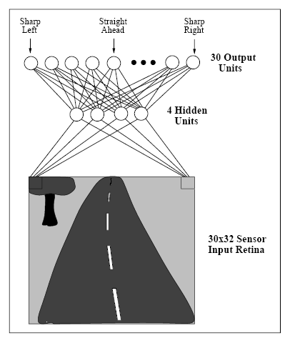
ALVINN’s 2-Layer Network
[Pomerleau, 1995]

Slide 93
ALVINN
Learning
continuously learns on the fly by observing
human driver (takes ~5 minutes from random initial weights)
itself (do an epoch of training every 2 seconds there after)
problem with using real continuous data:
there aren't negative examples
network may overfit data in recent images (e.g., straight road) at the expense of past images (e.g., road with curves)
solutions
generate negative examples by synthesizing views of the road that are incorrect for current steering
maintain a buffer of 200 real and synthesized images that keeps some images in many different steering directions
Notes:
CLICK EACH SUB

Slide 94
ALVINN
Results
drove at speeds up to 70 mph
drove continuously for distances up to 90 miles
drove across the U.S. during different times of the day and with different traffic conditions
drove on:
single lane roads and highways
multi-lane highways
paved bike paths
dirt roads
Notes:
CLICK EACH SUB

Slide 95
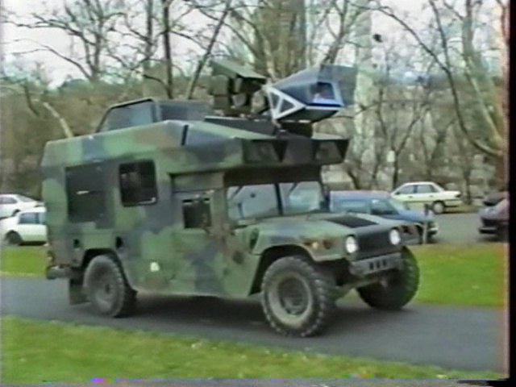
ALVINN Demo

Slide 96

Application: Face Detection
2 Classes:
Face/
Non-Face
NN
Classifier
Input = 20 x 20 pixel window, outputs a value ranging from –1 to +1 signifying the presence or absence of a face in the region
The window is positioned at every location of the image
To detect faces larger than 20 x 20 pixel, the image is repeatedly reduced in size

Slide 97
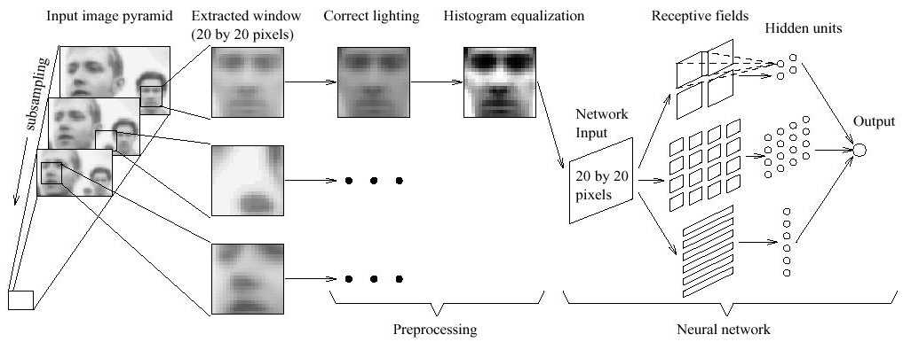
2-Layer Network

Slide 98
Application: Face Detection
2-layer feed-forward neural network
Three types of hidden units
4 look at 10 x 10 subregions
16 look at 5 x 5 subregions
6 look at 20 x 5 horizontal stripes of pixels
Training set
1,050 initial face images. More face examples generated from this set by rotation and scaling. Desired output: +1
Non-face training samples: 8,000 non-face training samples from 146,212,178 subimage regions! Desired output: -1

Slide 99
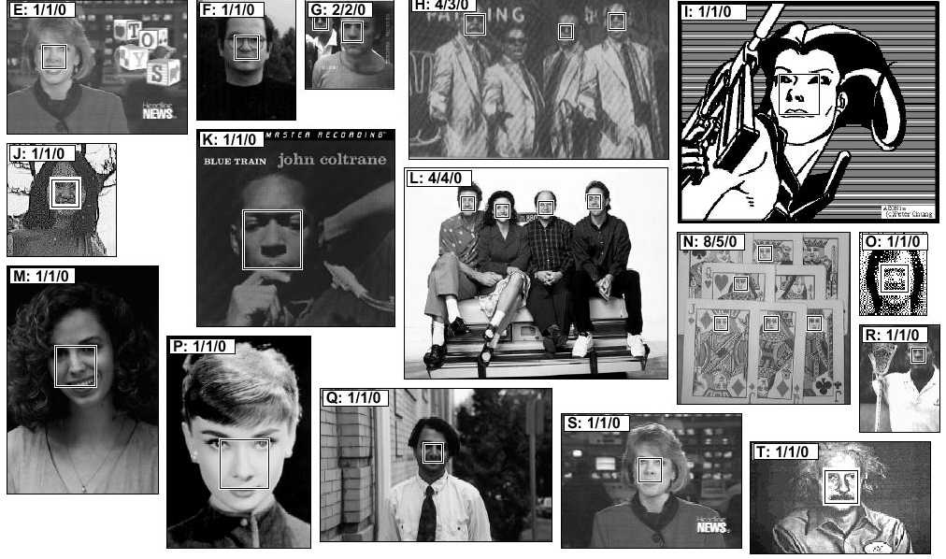
Face Detection Results

Slide 100
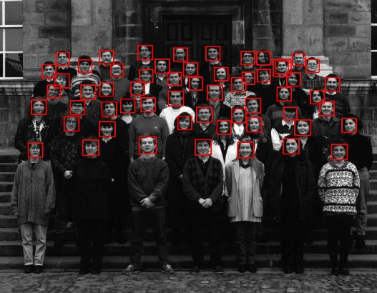

Results
Notice detection at multiple scales

Slide 101
Face Detection Demos (but not using neural nets)
http://flashfacedetection.com/
http://flashfacedetection.com/camdemo2.html

Slide 102
What is Wrong with Back-Propagation?
Requires labeled training data
Almost all data is unlabeled
Learning time does not scale well
It is very slow to converge in networks with multiple hidden layers
Can get stuck in poor local optima
Overfitting problem
from G. Hinton

Slide 103
Sigmoid Function
Slow learning because “saturated” units “kill” gradients
Derivative near 0
Derivative near 0

Slide 104
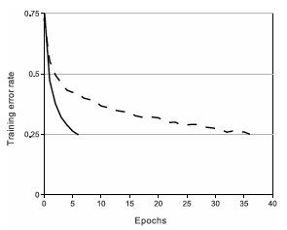
Speeding Up Training
Use ReLU instead of Sigmoid (or Tanh)
Rectified Linear Unit: g(x) = max(0, x)
ReLU reaches 25% error rate 6x faster than tanh
Computationally efficient
tanh
Training Error
ReLU
Epochs
Notes:
ReLU is computationally very efficient and converges much faster than Sigmoid or Tanh.

Slide 105
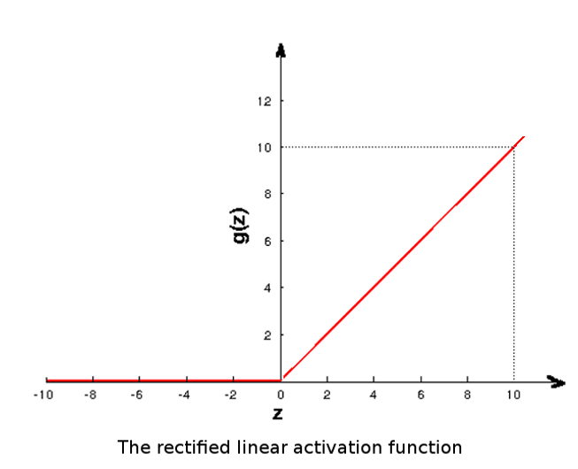
Rectified Linear Function (ReLU)

Slide 106
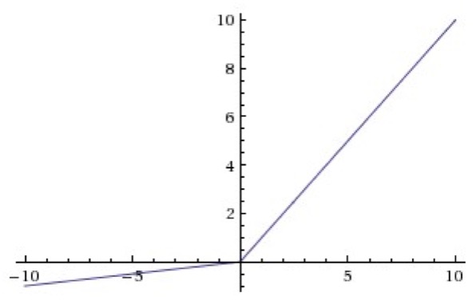
What’s the Derivative of the ReLU Function?
But this means when x ≤ 0 the unit will never update because Δ_{i} = 0
Fix using a variation such as “Leaky ReLU”:

Slide 107
Early NNs used only 1 or 2 hidden layers because training was slow, thought to converge to poor local minima, and overfit
Recent results suggest that local minima are not a serious problem – regardless of initial conditions, bigger NNs contain many more local minima but nearly all are solutions of very similar quality. And overfitting can be avoided using regularization techniques rather than using fewer units

Slide 108
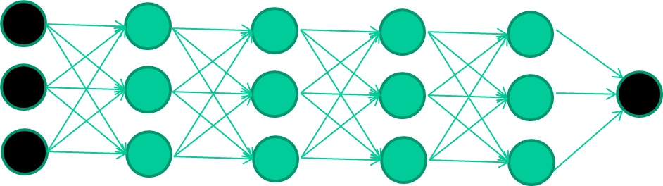
Deep Learning
Use many hidden layers (often 10-20)
Called Deep Neural Nets or Deep Nets

Slide 109

A Lot of Buzz about Deep Learning
July 2012 – Baidu starts DL lab
Nov 2012- Big improvement in Speech, OCR:
Speech – reduce Error Rate by 25%
OCR – reduce Error rate by 30%
2013 launched 5 DL based products
Voice search
Photo Wonder
Visual search

Slide 110
A Lot of Buzz about Deep Learning
Microsoft On Deep Learning for Speech
Notes:
goto 3:00-5:10

Slide 111
A Lot of Buzz about Deep Learning
Similarly, big groups at Facebook, Microsoft, Baidu, Amazon, …

Slide 112
Why Deep Learning?
Biological Plausibility – your brain works that way
Problems that can be represented with a polynomial number of nodes with k layers, may require an exponential number of nodes with k-1 layers（中文和拼音文字的構詞區別）
Highly varying functions can be efficiently represented with deep architectures
Less weights/parameters to update than a less efficient shallow representation
Sub-features created in deep architecture can potentially be shared between multiple tasks

Slide 113
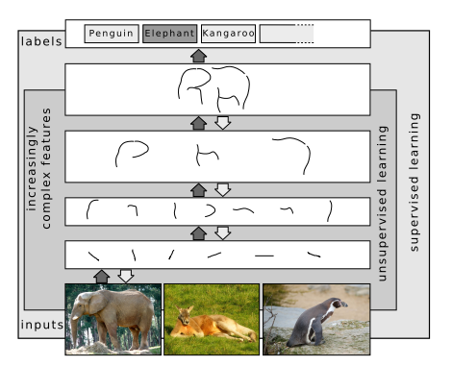
Hierarchical, Representation Learning
Natural progression from low-level to high-level features as seen in natural complexity
Automatically learns features from the raw data
Easier to monitor what is being learned and to guide the learner to better subspaces

Slide 114




Feature Hierarchies
object models
object parts
(combination
of edges)
edges
pixels
Andrew Ng

Slide 115
So, Multiple Layers Make Sense
Many-layer neural network architectures should be capable of learning the true underlying features and ‘feature logic’, and therefore generalize very well …

Slide 116
So, 1. what exactly is deep learning ?
And, 2. why is it generally better than other methods on image, speech and certain other types of data?
The short answers
1. ‘Deep Learning’ means using a neural network
with several layers of nodes between input and output
2. the series of layers between input & output do
feature identification and processing in a series of stages,
just as our brains seem to.

Slide 117
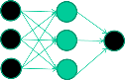
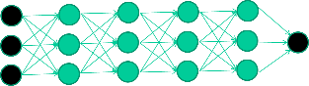
hmmm… OK, but:
3. multilayer neural networks have been around for
25 years. What’s actually new?
we have always had good algorithms for learning the
weights in networks with 1 hidden layer
but these algorithms are not good at learning the weights for networks with more hidden layers
what’s new is: algorithms for training many-layer networks

Slide 118
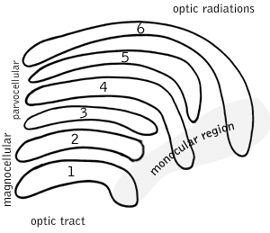
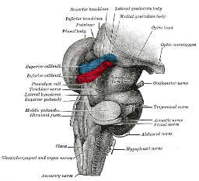
So: multiple layers make sense
Your brain works that way

Slide 119
Difficulties Training Deep Networks
Bottom layers do not get trained easily
Error attenuates（衰減） as it propagates to earlier layers
Leads to very slow training
For small data sets, not enough labeled data available for training

Slide 120
Pre-Train Multi-Layer NNs
Unsupervised pre-training:
Especially useful with small data sets to initialize weights

Slide 121
Pre-Train Multi-Layer NNs
Train this layer first

Slide 122
Pre-Train Multi-Layer NNs
Train this layer first
then this layer, etc.

Slide 123
Pre-Train Multi-Layer NNs
Train this layer first
then this layer
then this layer

Slide 124
Pre-Train Multi-Layer NNs
Train this layer first
then this layer
then this layer
then this layer

Slide 125
Pre-Train Multi-Layer NNs
Train this layer first
then this layer
then this layer
then this layer
finally this layer

Slide 126
Pre-Train Multi-Layer NNs
EACH of the (non-output) layers is trained to be an Auto-Encoder
That is, it is forced to learn good features that describe what comes from the previous layer

Slide 127
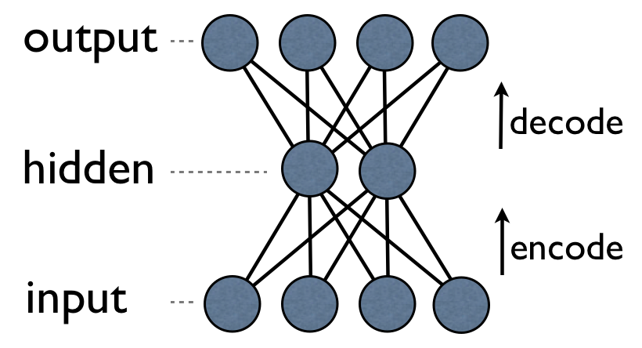
An Auto-Encoder is trained with a standard weight-adjustment algorithm to reproduce the input
By making this happen with fewer units than the inputs and/or sparse coding constraints, this forces the ‘hidden layer’ units to learn to be good feature detectors

Slide 128
Training a Deep Network
Pre-Training is used when amount of labeled training data is relatively small
Or used as a preprocessing step to initialize weights
Then use traditional back-prop to train the full network

Slide 129
Convolutional Neural Networks
also called CNNs and ConvNets

Slide 130
CNNs
Many applications process array data
1D: time-series, acoustic, text data
2D: images and audio spectrograms
3D: video and volumetric data
Properties of these types of data
Local, shift-invariant processing
Hierarchy of feature descriptions
Noisy data

Slide 131
Convolutional Neural Networks are an extension of traditional Multi-layer, feed-forward networks that incorporate 4 key ideas:
Use of many layers
Learn a hierarchy of features
Local “receptive fields” and local connections
Layers are not completely connected
Want translation-invariant and distortion-invariant local features
Shared weights
Pooling
Spatial / temporal sub-sampling

Slide 132
The Replicated Feature Approach: Local Connections and Shared Weights
Use many different copies of the same feature detector at different positions
Could also replicate across scale and orientation (tricky and expensive)
Replication greatly reduces the number of free parameters to be learned
Use several different feature types, each with its own map of replicated detectors
Allows each patch of image to be represented in several ways
The red connections all have the same weight.

Slide 133
What does Replicating the Feature Detectors Achieve?
Equivariant activities
Invariant knowledge: If a feature is useful in some locations during training, detectors for that feature will be available in all locations during testing
representation by active neurons
translated representation
translated image
image

Slide 134
Why are they called “Convolutional” NNs?
A Convolution is an operation defined on two arrays as follows:
In CNN’s, f corresponds to the inputs from the layer below and g corresponds to the weights
g
f
h = g ∗ f
Credit: K. Grauman

Slide 135
Convolution Layers
Learn “filters” (i.e., weights) that process small regions of the layer below it and compute “features” at many spatial positions
Example: 32 x 32 x 3 input RGB image, and receptive field: 5 x 5
Each unit in the Conv layer will have weights connected to a 5 x 5 x 3 region in the input layer, with 5*5*3=75 weights
Can have multiple units associated with a given receptive field in order to compute multiple features at each position
“Stride” parameter defines replication process

Slide 136
Pooling the Outputs of Replicated Feature Detectors
Get a small amount of translational invariance at each level by averaging four neighboring replicated detectors to give a single output to the next level
This reduces the number of inputs to the next layer
Taking the maximum of the four works slightly better
Problem: After several levels of pooling, we have lost information about the precise positions of things
This makes it impossible to use the precise spatial relationships between high-level parts for recognition
Notes:
Downsampling operation along the spatial dimensions

Slide 137

CNN Architecture
Notes:
FC = fully connected layer

Slide 138
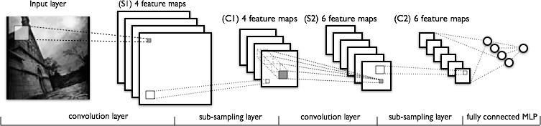
CNN Architecture
Convolutions and ReLU
Convolutions and ReLU
Max pooling
Max pooling

Slide 139
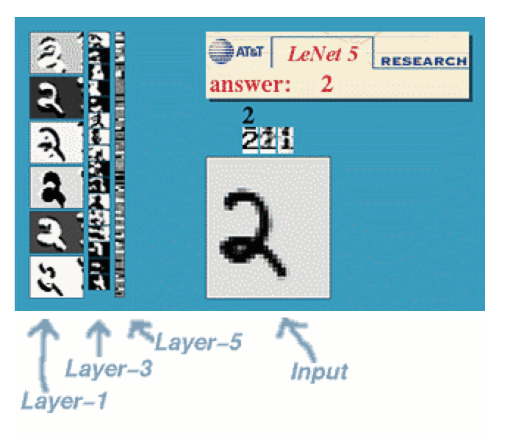
LeCunn’s Digit Recognizer: LeNet
http://yann.lecun.com/

Slide 140
LeNet
Yann LeCun and his collaborators developed a really good recognizer for handwritten digits by using backpropagation in a feed-forward net with:
Many hidden layers
Many maps of replicated units in each layer
Pooling of the outputs of nearby replicated units
A wide net that can cope with several characters at once even if they overlap
This net was used for reading ~10% of the checks in North America

Slide 141
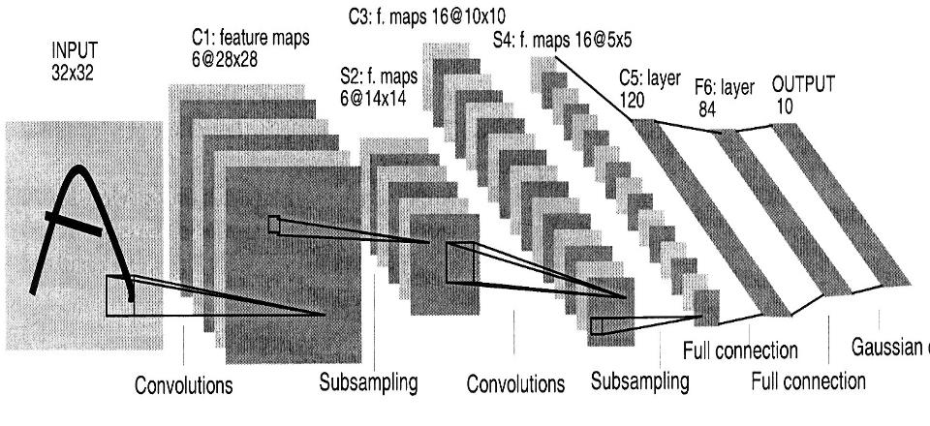
The Architecture of LeNet5

Slide 142
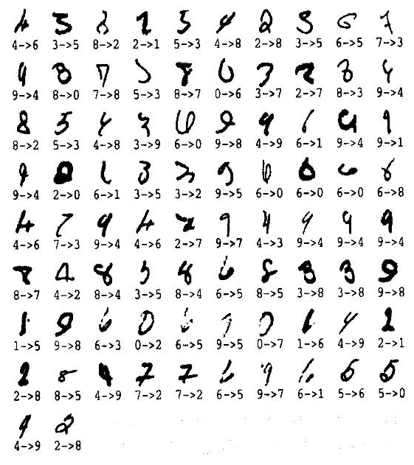
The 82 Errors made by LeNet5
Out of about 10,000 test cases
Notice that most of the errors are cases that people find quite easy

Slide 143
From Handwritten Digits to 3D Objects
Recognizing real objects in color photographs downloaded from the web is much more complicated than recognizing handwritten digits:
Hundred times as many classes (1000 vs 10)
Hundred times as many pixels (256 x 256 color vs 28 x 28 grayscale images)
2D image of three-dimensional scene
Cluttered scenes requiring segmentation
Multiple objects in each image
Will the same type of CNN work?

Slide 144
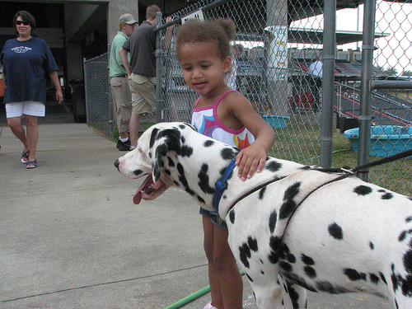
Large Scale Visual Recognition Challenge (ILSVRC)
Training set: 1.2 million 256 x 256 RGB images
Classification task:
Get the “correct” class in your top 5 bets. There are 1000 classes
Localization task:
For each bet, put a box around the object. Your box must have at least 50% overlap with the correct box
Dalmatian

Slide 145
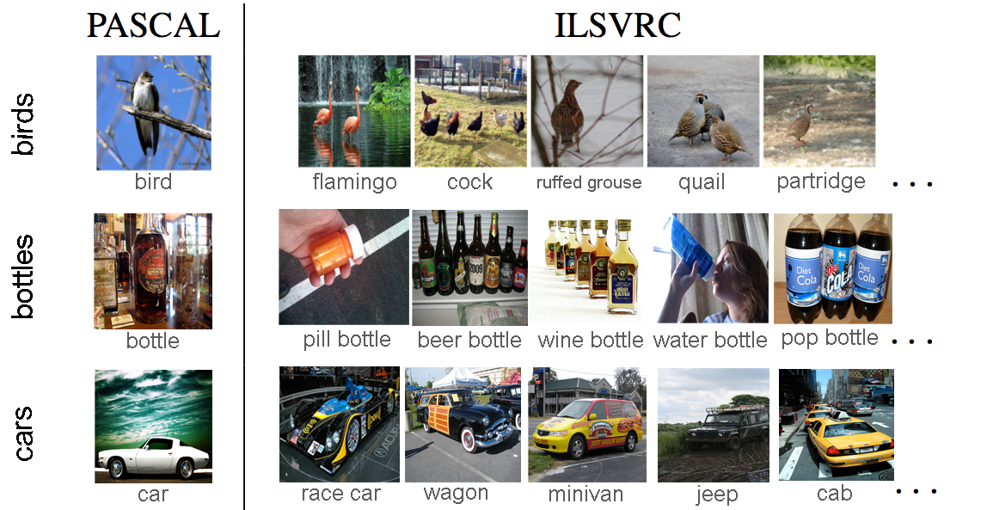
Variety of Object Classes in ILSVRC

Slide 146
SuperVision (SV)
A. Krizhevsky, I. Sutskever, G. Hinton, NIPS 2012
CNN with
7 hidden layers, 650K units, 60M weights, 630M connections
Rectified Linear Units, max pooling, dropout trick
Randomly extracted 224 x 224 patches for more data
Trained with SGD on two GPUs for a week, fully supervised, for “roughly 90 cycles”
Classification: “Top-1” error rate: 37.5%, “Top-5” error rate: 17%
Localization: Regression on (x,y,w,h)
http://image-net.org/challenges/LSVRC/2012/supervision.pdf
Notes:
Very impressive results given poor localization

Slide 147
CNN for ILSVRC 2010
Training took 5-6 days on two 3 GB GPUs
Trained for “roughly 90 cycles”
Testing set consisted of 150,000 images
“Top-1” error rate: 37.5%
“Top-5” error rate: 17%
5 convolutional layers
3 fully connected layers
650K neurons , 60 million weights

Slide 148
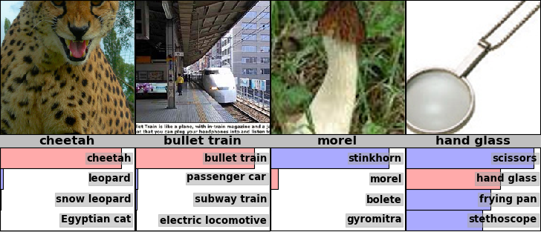
Examples from the Test Set (with the network’s guesses)

Slide 149

ILSVRC 2012
ImageNet database: 14 million labeled images, 20K categories

Slide 150
Example Classification Results

Slide 151
ImageNet Classifications 2012

Slide 152
Error Rates on the ILSVRC 2012 Competition
classification
& localization
classification
University of Toronto (CNN)
University of Tokyo
Oxford University
INRIA + Xerox
University of Amsterdam
16.4% 34.1%
26.1% 53.6%
26.9% 50.0%
27.0%
29.5%

Slide 153
ILSVRC 2012: top rankers
http://www.image-net.org/challenges/LSVRC/2012/results.html
N | Error-5 | Algorithm | Team | Authors
1 | 0.153 | Deep Conv. Neural Network | Univ. of Toronto | Krizhevsky et al
2 | 0.262 | Features + Fisher Vectors + Linear classifier | ISI | Gunji et al
3 | 0.270 | Features + FV + SVM | OXFORD_VGG | Simonyan et al
4 | 0.271 | SIFT + FV + PQ + SVM | XRCE/INRIA | Perronin et al
5 | 0.300 | Color desc. + SVM | Univ. of Amsterdam | van de Sande et al

Slide 154
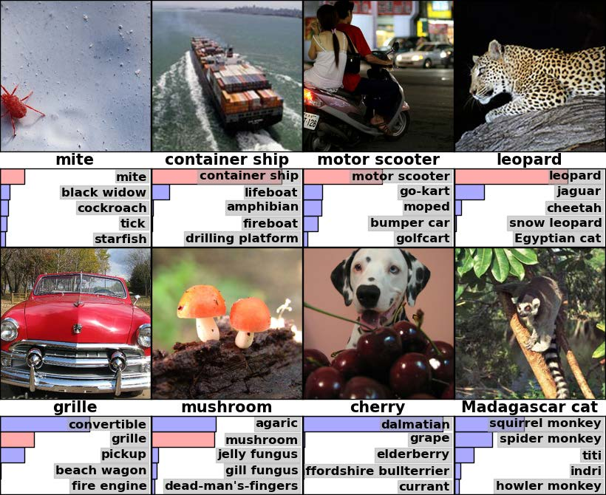
Examples of how well the CNN worked for object recognition

Slide 155
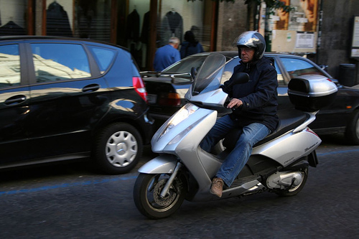
ILSVRC 2013 with Large-Scale Object Detection
Fully annotated 200 object classes across 60,000 images
Person
Car
Motorcycle
Helmet
Allows evaluation of generic object detection in cluttered scenes at scale
http://image-net.org/challenges/LSVRC/2013/
3x
Notes:
In this challenge, we focused on 1000 object classes

Slide 156
ImageNet 2013: top rankers
http://www.image-net.org/challenges/LSVRC/2013/results.php
N | Error-5 | Algorithm | Team | Authors
1 | 0.117 | Deep Convolutional Neural Network | Clarifi | Zeiler
2 | 0.129 | Deep Convolutional Neural Networks | Nat.Univ Singapore | Min LIN
3 | 0.135 | Deep Convolutional Neural Networks | NYU | Zeiler Fergus
4 | 0.135 | Deep Convolutional Neural Networks |  | Andrew Howard
5 | 0.137 | Deep Convolutional Neural Networks | Overfeat NYU | Pierre Sermanet et al

Slide 157
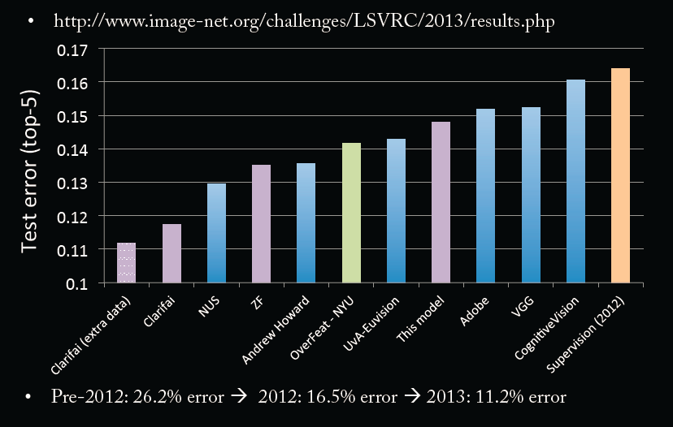
ImageNet Classifications 2013

Slide 158


CNNs for Object Detection and Recognition

Slide 159
CNNs for Object Detection
Sermanet, CVPR 2014

Slide 160
CNNs for Scene Parsing
Farabet, PAMI 2013

Slide 161
CNNs for Scene Semantic Labeling RGBD Images
Farabet, 2013

Slide 162
CNNs for Action Detection
Taylor, ECCV 2010

Slide 163
Deep Learning Demos and Startups
Clarifai
http://www.clarifai.com
Dextro
www.dextro.co
Yann LeCun’s Digit Recognizer
http://yann.lecun.com/exdb/lenet/
Toronto Deep Learning Demos
http://deeplearning.cs.toronto.edu/

Slide 164


Number Recognition from Google’s Street View Images

Slide 165
Number Recognition from Google’s Street View Images
Training set: 200,000 images of (cropped) house numbers (up to 5 digits long)
CNN with 11 hidden layers
54 x 54 input image layer
8 convolutional layers
48 x 54 x 54 = 140,000 units at first hidden layer
5 x 5 convolution kernels
1 locally-connected hidden layer
2 densely-connected hidden layers
3,072 units in each

Slide 166
Training time: 6 days
Accuracy: Transcribed ~100 million numbers with ~98% accuracy (meaning all numbers in a sequence were recognized correctly) and 95% coverage

Slide 167

Automatically
extracted street
numbers in a South Africa neighborhood

Slide 168

Caffe
Caffe is an open source deep learning library written in C++ made with expression, speed, and modularity in mind
http://caffe.berkeleyvision.org/
http://demo.caffe.berkeleyvision.org/

Slide 169

ConvNetJS is a Javascript library for training Deep Learning models (Neural Networks) entirely in your browser
http://cs.stanford.edu/people/karpathy/convnetjs/

Slide 170


Slide 171


Slide 172


Slide 173

Application: Object Recognition
GoogLeNet:
table lamp
lamp shade
printer
projector
desktop computer

Slide 174

Application: Object Recognition
Example: Images from the web
Download 10,000,000 images
Train a 9-layer CNN
Concepts are formed by CNN
→ 70% better than previous state of the art
Building High-level Features Using Large Scale Unsupervised Learning, Q. Le, M. Ranzato, R. Monga, M. Devin, K. Chen, G. Corrado, J. Dean, and A. Ng

Slide 175

Application: Game Playing
Enduro, Atari 2600
Expert player: 368 points Deep Learning: 661 points
Playing Atari with Deep Reinforcement Learning, V. Mnih, K. Kavukcuoglu, D. Silver, A. Graves, I. Antonoglou, D. Wierstra, M. Riedmiller

Slide 176

Deep Learning is providing breakthrough results in speech recognition and image classification …
From this Hinton et al 2012 paper:
http://static.googleusercontent.com/media/research.google.com/en//pubs/archive/38131.pdf
go here: http://yann.lecun.com/exdb/mnist/
From here:
http://people.idsia.ch/~juergen/cvpr2012.pdf

